Slide 1

Gettin’ Literate Wit It

Slide 2




What is Literacy?
Reading
Writing
Listening
Speaking
Understanding Pictures (Visual)
Understanding Technology (Media)

Slide 3



How are readers now?
40% of the nation’s fourth graders are “below basic” (National Institute for Literacy)
Both Russia and the United Kingdom have higher literacy and fluency rates than Americas students. (United Nations)
The literacy rate in America is the same as in Israel (United Nations)

Slide 4

How are writers now?
4 out of 5 students are not proficient writers
80% of 12th grade seniors graduate without proficient writing skills
According to the National Center for Education statistics

Slide 5
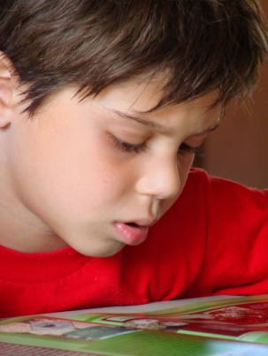
How are adults now?
22% of adults are considered “below basic” in reading fluency (Family Literacy Centers)
50% of American adults are unable to read and comprehend an 8th grade book (Illiterate America by Jonathon Kozol)
46% of American adults are unable to accurately understand the label on their prescription medicine (Journal of American Medical Association)
3% of adult Americans cannot read at all (United Nations)

Slide 6

And even scarier….
2/3rd of the students who cannot read proficiently by the end of the 4th grade will end up in jail or on welfare (Family Literacy Centers)
70% of inmates in America’s prisons cannot read or write above a 4th grade level (Department of Justice)
When the State of Arizona projects how many prison beds it will need, it factors in the number of kids who can’t read well in 4th grade (Arizona Republic article 9-15-2004)
Still, one in four children growing up not knowing how to read or write proficiently (Family Literacy Centers)

Slide 7
What does this mean?
This doesn’t mean that if you’re not a fluent reader that you’ll automatically become a robber, thief, or murderer!
This does mean that if you don’t have the skills of reading and writing, you’re more likely to lose out on other skills, or even miss out on opportunities to better your life.
  Someone who doesn’t have the skills to be considered literate is more likely to be unemployed or underpaid, therefore putting them into more difficult life situations. (Richmond County Literacy Network)

Slide 8

So how can literacy help you?
By reading independently just 15 minutes a day, you can be exposed to more than a million words of text a year (Anderson, Wilson, and Fielding study 1988)
“Writing is a key skill for getting a job, and getting promoted,” says a report from the NCW and Business roundtable.
80% of employers in the Finance, Insurance, or Real Estate industry frequently consider writing skills in hiring

Slide 9
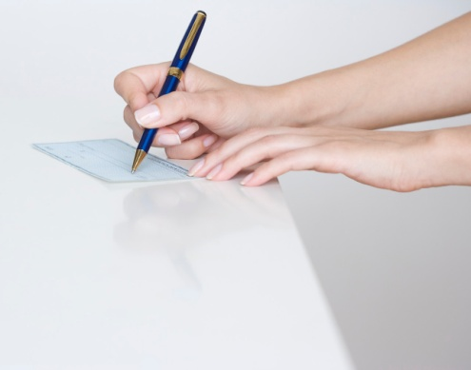
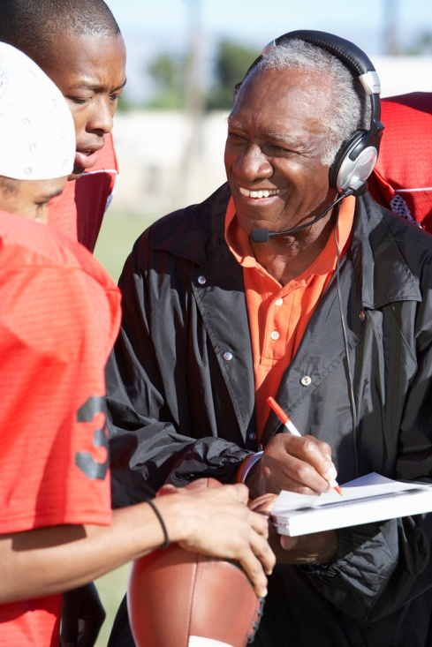

So how can literacy help you?
Being literate has been proven to:
  Help people both get and keep jobs
  Avoid unemployment
  Increase your income/salary
  Make you more likely to be promoted
  Making a person physically healthier
  (Richmond County Literacy Network)

Slide 10

Ms. Panther’s response:
You will be Writing on Demand each week! Don’t freak out; this is what it will look like:
The first day of the week (usually Monday) you will be presented with several writing prompts with clear directions and all the resources you need. One will be based on an article I provide, and another will be a creative writing challenge.
I will also give you examples of responses
We will use this week to practice Writing on Demand, it will not be for a grade

Slide 11
Ms. Panther’s response:
Monday: You choose the prompt you want to respond to, look over the information and examples provided
Tuesday through Thursday: You will be given work time in class to create your piece of writing. The first five minutes of class will always be WOD time. You can use this time to research, draft, edit, revise, ask for help, or read if you finish early. You may not be out of your seat or be off task.
Friday: Three to five students will be randomly selected to present their work in an informal way. All students will turn in their work for the weeks either in print or electronically.

Slide 12
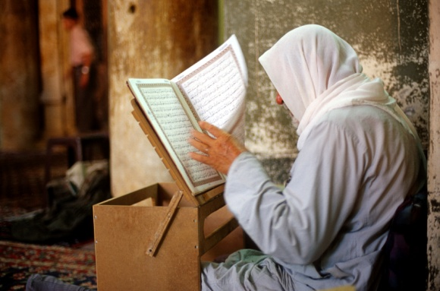
Assessment
  When you turn in your Writing on Demand assignment each Friday, I will be grading on the 3, 2, 1 scale that translates into a 20% grade. Elements I am looking for include:
  Preparation Is the student working at the bell? Are they creating content independently?
  Participation Are the students completing the tasks daily? Do they complete the projects to the best of their abilities?
  Practice Does the student apply knowledge from class to the assignments?

Slide 13
Assessment
However, I will randomly choose several of you to present your Writing on Demand each Friday. These lucky few people will briefly discuss what they wrote about and turn it in for an 80% assessment grade
Every student will have at least two 80% Writing on Demand grades in a semester
Every student will turn in an assignment on Fridays expecting it to be their 80% grade

