Slide 1
Broadcasting
This or That?

Slide 2
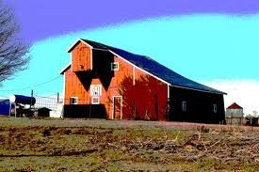
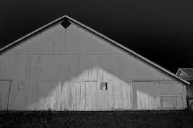
Looking Back….
Which picture is better? Why?

Slide 3
Looking Back
Find the lightest color and darkest color. Count the number of colors in-between.
Are there are three or less? LOW CONTRAST
Are there three or more? HIGH CONTRAST

Slide 4
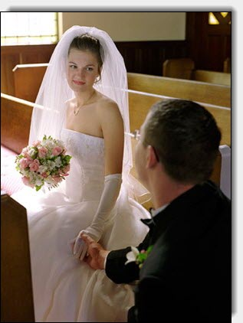
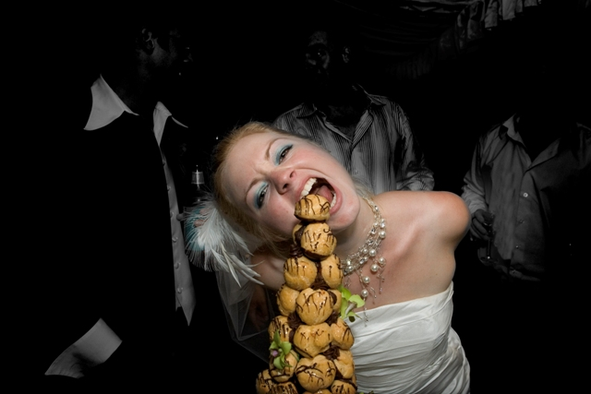
Looking Back…
Which photo is better? Why?

Slide 5
Looking Back….
Does the person not known the photo is being taken? Not care? CANDID
Does the person know the photo is being taken and they change their actions because of it? POSED

Slide 6
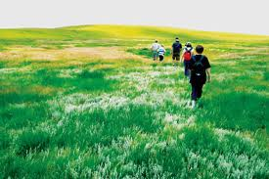
Looking Back….
Which photo is better? Why?

Slide 7
Looking Back….
Is the focal point off center? Towards an edge? RULE OF THIRDS
Is the focal point in the middle? CENTRAL FOCAL POINT

Slide 8
Right Now.
Next Project:
Use your prior knowledge of visual publications (including photography and advertising) to create a visually appealing broadcast
Use your prior knowledge of print publications (including interviews and journalism) to create a well scripted broadcast
Use your knowledge of editing and graphic design to edit film to create a broadcast
Learn how to combine these skills to create a broadcast

Slide 9
Right Now.
A few examples:
www.misspanther.weebly.com
One of the few places you’ll be able to see your completed work!

